Slide 1

What, When, and How of Biomarker Testing in Patients with NSCLC
Gregory J. Riely
March 23, 2017
@RielyMD

Slide 2
Main Things I Would Like You to Learn
Biomarker testing for patients with non-small cell lung cancer is critically important.
Biomarker testing for patients with non-small cell lung cancer is a little complicated.
Optimally, biomarker testing should be done at diagnosis, but if it cannot be done then, testing before choice of “second-line” therapy has value
Multiplexed biomarker testing offers the best opportunity to learn about the relevant events.
Biomarker testing is now critically important in the setting of resistance to initial therapy for patients with EGFR mutant NSCLC

Slide 3
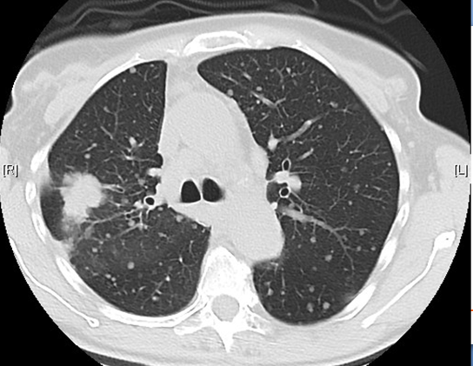
Case
64 year old woman with no significant past medical history.
Presents with cough.
CT shows dominant right lung mass and numerous bilateral pulmonary lesions.
Biopsy of dominant mass shows adenocarcinoma.
What additional tests should be done with the pathology?

Slide 4
The Current Approach to First-Line Treatment of Patients with Advanced NSCLC
Stage IV NSCLC
Targeted Therapy
Molecular Analysis +
PD-L1 Testing
Platinum-based Chemotherapy (squamous vs non-squamous)
EGFR, ALK
ROS1
PD-L1 <50%
~25%
of patients
PD-L1 ≥50%
~45%
of patients
Pembrolizumab
~30%
of patients

Slide 5
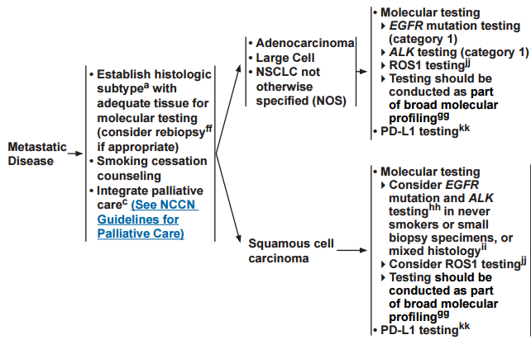
The Current Approach to Evaluation of Patients with Advanced NSCLC

Slide 6
The Current Approach to Evaluation of Patients with Advanced NSCLC

Slide 7
Two categories of biomarkers
DNA
-Sequencing
- FISH
Protein
Immuno-histochemistry (IHC)
Notes:
Current technologies and data types used for biomarker discovery in preclinical and clinical research. Abbreviations: CNV, copy number variations; FISH, fluorescence in
situ hybridization; GCMS, gas chromatography mass spectrometry; HPLC, high-performance liquid chromatography; LCMS, liquid chromatography–mass
spectrometry; NMR, nuclear magnetic resonance; PCR, polymerase chain reaction; SNPs, single nucleotide polymorphisms; SVs, structural variations.

Slide 8
The Current Approach to First-Line Treatment of Patients with Advanced NSCLC
Stage IV NSCLC
Biomarker Evaluation
EGFR, ALK
ROS1
PD-L1 <50%
PD-L1 ≥50%

Slide 9
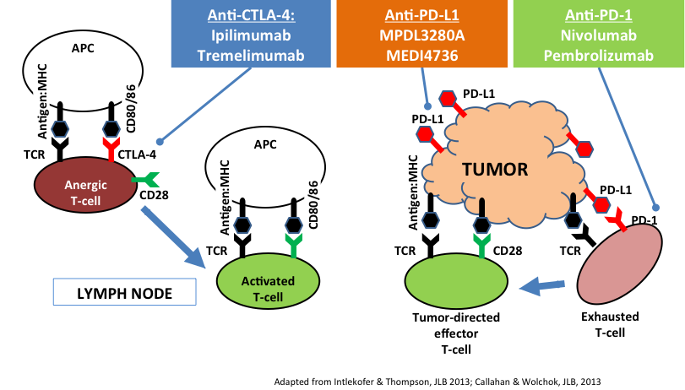
Basics of Immunotherapy
Anti-PD-L1
Atezolizumab
Durvalumab

Slide 10
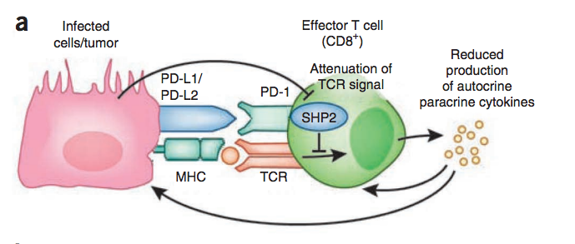
The Immunological Synapse
Okazaki et al, Nature Immunology 2013

Slide 11
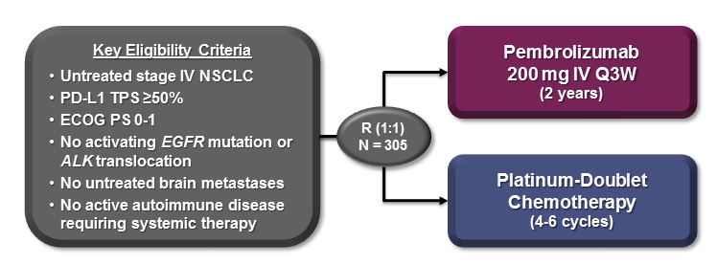
Pembrolizumab vs Chemotherapy
in Patients who are PD-L1 ≥ 50%
Reck et al, ESMO 2016

Slide 12
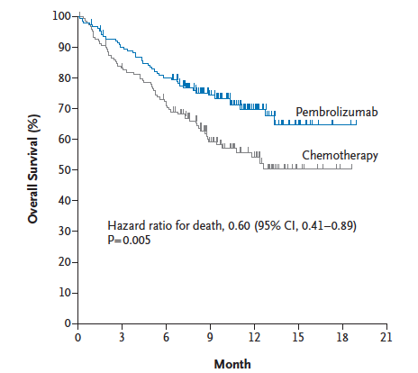
Pembrolizumab vs Chemotherapy in Patients who are PD-L1 ≥ 50%
Reck et al, NEJM 2016

Slide 13
PD-L1 Tests are all over the map
Drug/ Sponsor | Nivolumab BMS |  | Pembrolizumab Merck |  | Atezolizumab Genentech |  |  | MEDI4736 AZ/MedImmune
Assay | 28-8 |  | 22C3 |  | SP142 |  |  | SP263
Cells scored | Tumor cells |  | Tumor cells and intercalated ICs |  | TC and IC |  |  | Tumor cells
Tissue | Archival |  | Recent |  | Arch./Recent |  |  | Arch./Recent
Setting | 1st line | 2L ++ | 1st line | 2L ++ | 2L ++ |  |  | 2L ++
Cut-point | 5% | None | 50% | 1%, 50% | TC 1+ | TC 2+ | TC 3+ | 25%
 |  |  |  |  | IC 1+ | IC 2+ | IC 3+

Slide 14
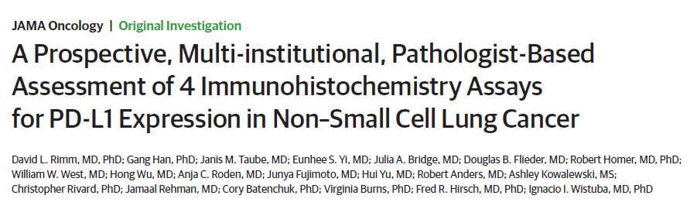
Rimm et al, JAMA Onc 2017

Slide 15
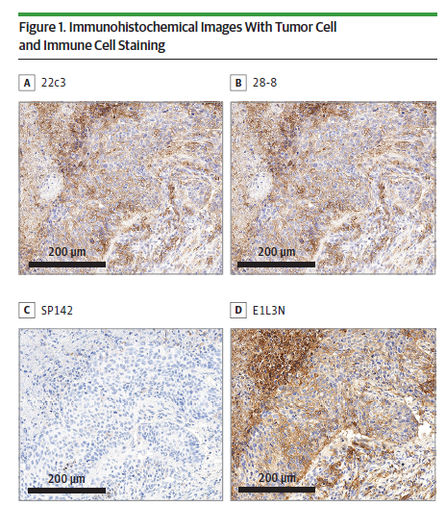
PD-L1 Staining can be different with different antibodies
Rimm et al, JAMA Onc 2017

Slide 16
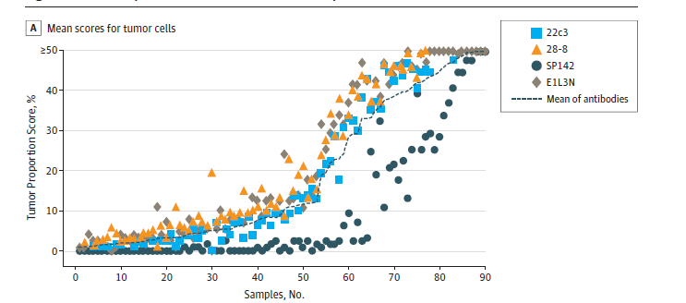
There is general concordance of PD-L1 testing… with one exception
Rimm et al, JAMA Onc 2017

Slide 17
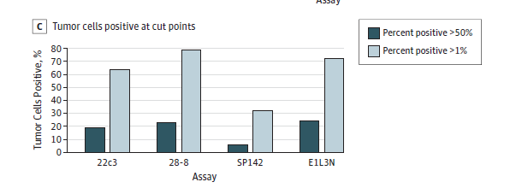
There is general concordance of PD-L1 testing… with one exception
Rimm et al, JAMA Onc 2017

Slide 18
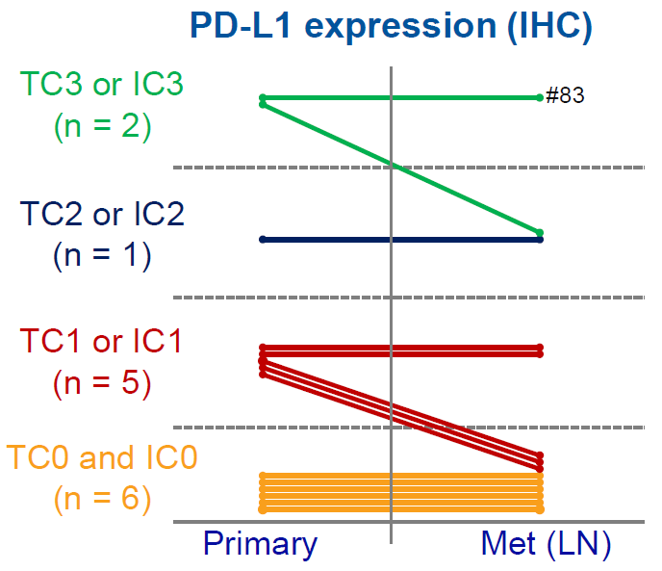
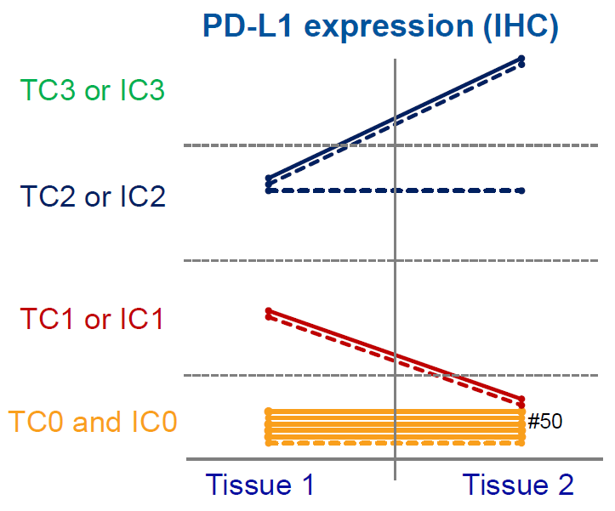
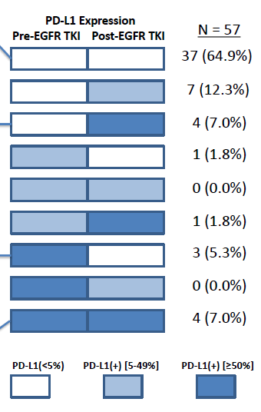
PD-L1 as a biomarker: Old biopsy or New?
Synchronous
Metachronous
PD-L1 expression appears to be relatively stable
72% no change in PD-L1 pre vs post-TKI
Kowanetz WCLC 2015
Gainor, CCR 2016

Slide 19
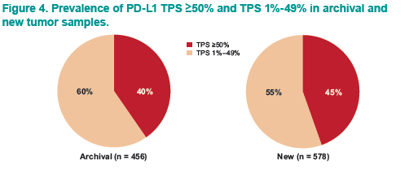
PD-L1 as a biomarker: Old vs New?
Herbst, ASCO 2016

Slide 20
Summary – PD-L1 Testing
Testing should be done in all patients with newly diagnosed NSCLC because this test gives an opportunity for first-line immunotherapy for patients with PD-L1 ≥50%.
Multiple antibodies for PD-L1 lead to largely concurrent results with exceptions.
PD-L1 testing is probably “stable” and there is no clear benefit to repeat biopsy for assessment of PD-L1 unless the prior sample is exhausted.

Slide 21
The Current Approach to First-Line Treatment of Patients with Advanced NSCLC
Stage IV NSCLC
Biomarker Evaluation
EGFR, ALK
ROS1
PD-L1 <50%
PD-L1 ≥50%

Slide 22
Subtypes of NSCLC can be defined by genotypes
MSK-IMPACT data

Slide 23
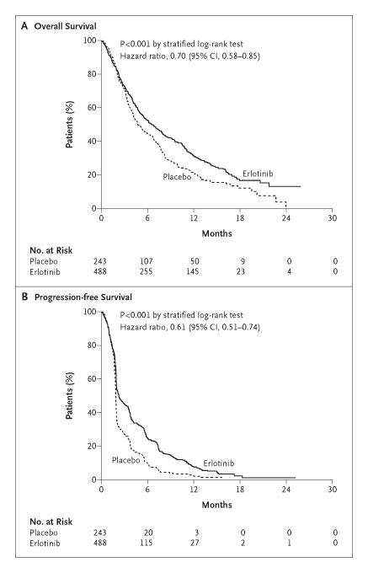
Randomized Trial of Erlotinib in non-small cell lung cancer
Response Rate 9%
Shepherd et al NEJM 353:123-132

Slide 24
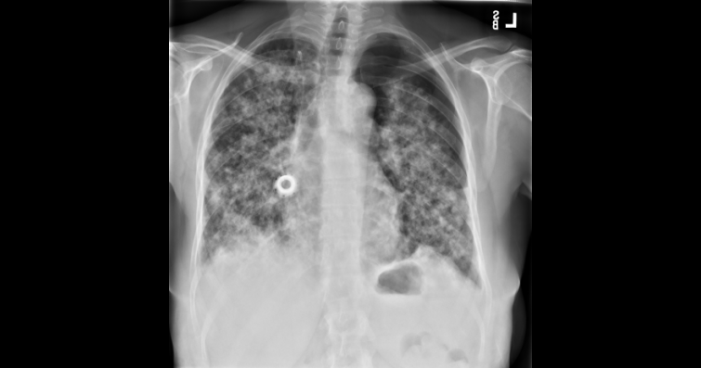
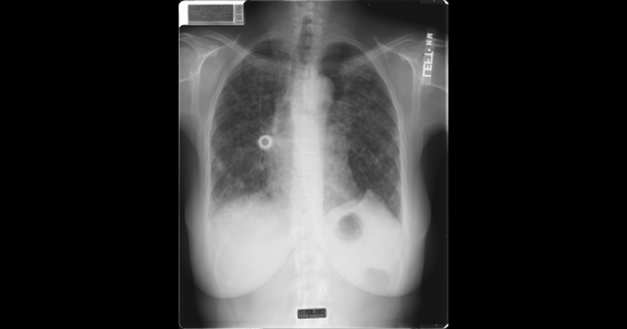
Why Are 1 in 10 Like This?
Day 1
Day 5

Slide 25
Why Are 1 in 10 Like This?
Clinical Factors Initially Used to Predict Response:
Adenocarcinoma
Never Smokers
East Asian ethnicity
Women
But, in 2004, EGFR mutations were identified and associated with response to erlotinib and gefitinib
Day 1
Day 5

Slide 26
EGFR TKI vs Carboplatin - Paclitaxel in Never- or Light Ex-Smokers (IPASS)
Measurable Stage IIIB or IV
Adenocarcinoma histology
No prior chemotherapy
PS 0-2
<100 cigarettes/lifetime or <10 pack- years and stopped ≥15 years prior
R
A
N
D
O
M
I
Z
E
Gefitinib 250 mg/day
Carboplatin AUC 5 or 6
Paclitaxel 200 mg/m²
q3wk (max 6 cycles)

Slide 27
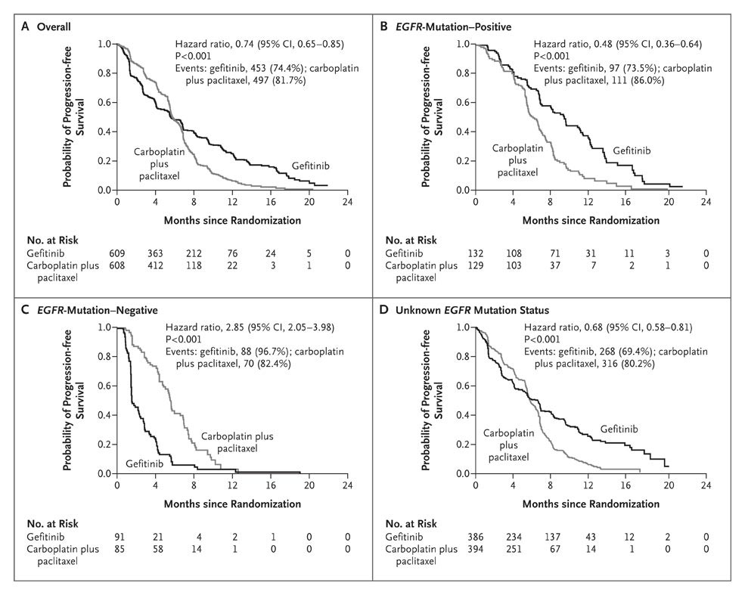
EGFR TKI vs Carboplatin-Paclitaxel
Mok TS, et al. N Engl J Med. 2009;361(10):947-957.
Mok et al NEJM 2009

Slide 28
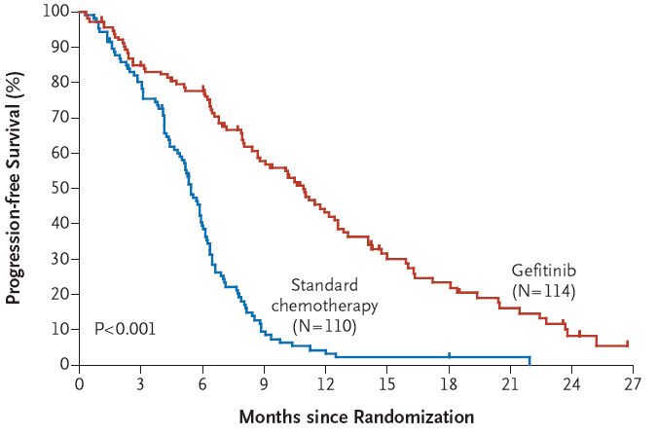
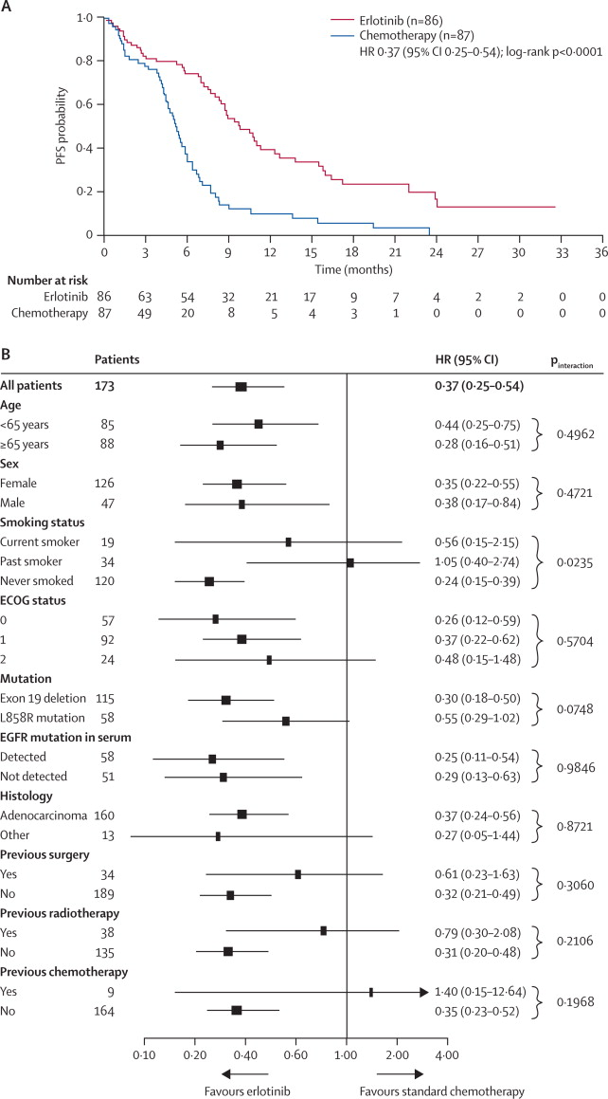
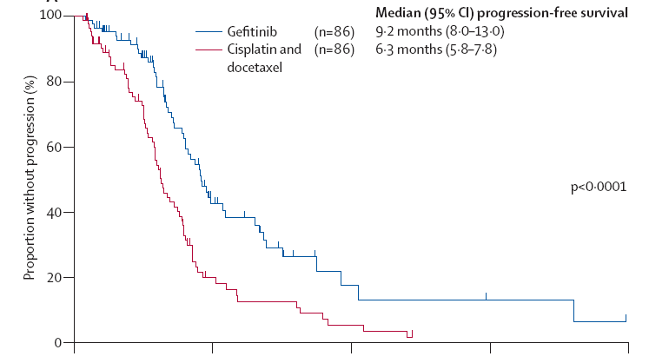
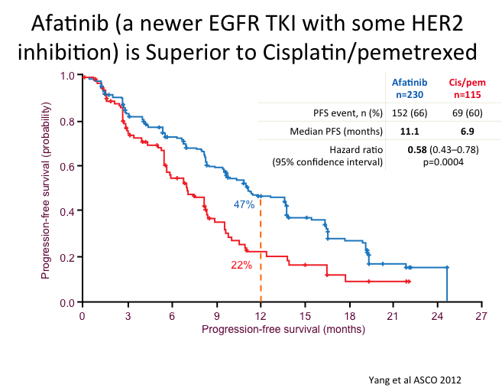
In Numerous Prospective Trials,
EGFR Tyrosine Kinase Inhibitors
(Erlotinib, Gefitinib, or Afatinib)
are better than platinum doublets
in patients with EGFR mutant NSCLC
Maemondo et al NEJM 2010, Mitsudomi et al Lancet Oncol 2010, Rosell et al Lancet Oncol 2012, Sequist et al, 2014

Slide 29
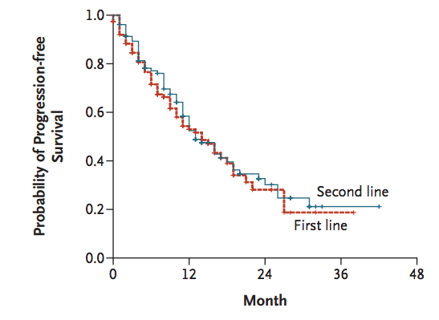
For molecularly targeted therapies, line of therapy may not matter
Erlotinib in patients with EGFR mutant NSCLC
Rosell et al, NEJM 2009; 361:958-67

Slide 30
Patients with NSCLC have Targetable Genetic Alterations
Target | First line | Second Line
EGFR | Gefitinib Erlotinib Afatinib | Osimertinib
ALK fusions | Crizotinib | Ceritinib Alectinib
BRAF V600E | Dabrafenib +Trametinib
ROS1 fusions | Crizotinib
RET | Cabozantinib
MET exon 14 | Crizotinib

Slide 31
How do we find all of these genetic alterations?

Slide 32
The Current Approach to Evaluation of Patients with Advanced NSCLC

Slide 33
How do we detect these abnormalities?
 | Used for
Immunohistochemistry | PD-L1, ALK, ROS1, EGFR mutations (rarely) | Quick, indvidual assays use one slide, but if testing many, can quickly add up, not available for most mutations
FISH | ALK, ROS1, RET | Quick, requires experienced personnel, one gene at a time
DNA sequencing | EGFR, BRAF, MET exon 14 | useful for any mutation, tests can be can be “multiplex” allowing evaluation of numerous genes at one time, can take days to weeks.

Slide 34
Biomarker Testing Needs to be Customized to Institution
No single answer for all institutions.
Goal should be results to treating doctor within 10 days
Oftentimes, institutions use a combination of techniques to achieve comprehensive evaluation in a timely manner that is tissue efficient

Slide 35
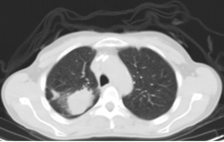
50 year old man with metastatic EGFR mutant (exon 19 deletion) lung adenocarcinoma involving lung and liver. Initially treated with erlotinib. After 13 months of treatment, now with progressive disease. What’s the next step?

Slide 36
All patients will develop acquired resistance to EGFR TKI
Median 10.8 vs 5.4 months, HR 0.30,
Maemondo, NEJM 2010

Slide 37
What causes resistance?
erlotinib
Development of Clinical Resistance to EGFR TKI
Diagnosed with EGFR mutant NSCLC
Biopsy to understand mechanism of resistance

Slide 38
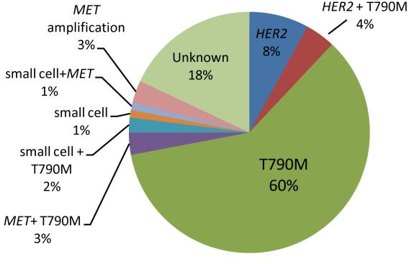
Mechanisms of Acquired Resistance to EGFR Tyrosine Kinase Inhibitors
Yu et al, CCR 2013

Slide 39
Spectrum of Activity of EGFR TKIs
 | Drug | EGFR L858R | EGFR Exon 19 del | EGFR T790M | EGFR
1st gen | gefitinib | + | + | - | +
 | erlotinib | + | + | - | +
2nd gen | afatinib | + | + | - | +
3rd gen | osimertinib | + | + | + | -

Slide 40
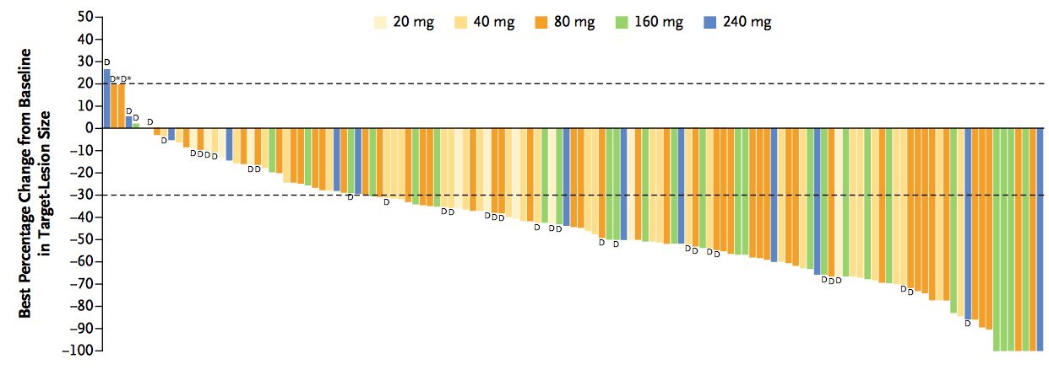
Osimertinib in Patients With Acquired Resistance to EGFR TKI and EGFR T790M
Response Rate = 61%

Slide 41
How I Treat Patients with EGFR mutant NSCLC
Identify EGFR mutation
Treat with 1st/2nd Gen EGFR TKI
Start Osimertinib
+
Clinical
Progression
Test Plasma for
EGFR T790M
-
Biopsy with
Tumor EGFR Testing
-
+
Start Chemotherapy
Start Osimertinib

Slide 42
Molecular Summary
EGFR, ALK, and ROS1 are examples of oncogene-addicted lung cancers.
Routine testing for these oncogenes should be standard for patients with NSCLC.
In patients with EGFR mutant NSCLC, they need to have molecular profiling again at the time of resistance to first-line EGFR TKI

Slide 43
Conclusions
Biomarker testing for patients with non-small cell lung cancer is critically important.
Optimally, biomarker testing should be done at diagnosis, but, testing before choice of “second-line” therapy has value
Multiplexed biomarker testing offers the best opportunity to learn about the relevant events.
Biomarker testing is now critically important in the setting of resistance to initial therapy for patients with EGFR mutant NSCLC

Slide 44
Extent of sequencing
Broad
Whole genome
Whole transcriptome
Targeted
Amplicon capture
Whole exome
Hybrid capture
Primarily research labs
Unbiased approach – extensive information
Broad coverage at the expense of depth
Higher cost
Longer TAT – not suitable to make therapeutic decisions in some settings
Clinical use
Higher coverage of genomic regions of interest
Lower cost and time.
Enrichment methods to improve detection
Aids in therapeutic decision making at adequate time frame

